Slide 1
DATA606 - Project Presentation
Hotel Booking Cancellation Analysis and More
Group 4 - Harold Lee, Radhika Joshi, Alex Papparis, David St. George, Daniel Zhou
Instructor - Dr. Wenjun Jiang
TA - Christian Chan, Lin Guo
February 16, 2022

Slide 2

Introduction & Background
In 2019, tourism and travel brought in 42.8 billion USD⁽¹⁾ to Portugal, contributing to 19.8% of GDP.⁽²⁾
Considering that it is such an important part of the economy, being able to maximize efficiency of hospitality management would be beneficial.
The rise of data science has enabled businesses to utilize historical client data to create profiles in attempts to maximize profits and minimize liabilities.
Picture taken from VisitPortugal.com⁽³⁾

Slide 3
Dataset Description
'Hotel Booking Demand Dataset' acquired from Kaggle⁽⁴⁾
Originated from ScienceDirect ⁽⁵⁾, authored by Nuno Antonio, Ana de Almeida, Luis Nunes
Consists of hotel demand data from two hotels in Portugal from July 2015 to August 2017
One hotel located in Lisbon (classed ‘City Hotel’)
Another located in Algarve region (classed ‘Resort Hotel’)
Dataset includes 119,390 datapoints, each datapoint representing a single hotel room booking. There are 32 variables, containing both qualitative (binary and nominal) and quantitative variables (discrete and continuous).
The 2 variables that we will use as response variables in our analysis are:
Variable Name | Type | Description
is_canceled | Binary | Status of the booking 1 = cancelled 0 = not cancelled
adr | Continuous | Average daily rate of stay in Euros(€)

Slide 4
Data Wrangling
Data wrangling was done at the beginning to clean erroneous or dirty data from our dataset.
Some of the steps we did were:
Reducing the factor levels of our variables (ex. 'Undefined' and 'SC' both means no meal package according to the dataset documentation, we unified the 2 variables under 'SC')
Removing rows with NULL / Undefined values in columns where it's clear that NULL should not be present.
Removed other erroneous datapoints (ex. there were datapoints indicating that a booking was neither on a weekday nor weekend, which is obviously impossible)
Added additional variables that helps with our analysis (ex. 'arrival date season' variable was added to see if the season of the booking would affect our response variables)
Factored variables as needed
We tried to preserve as much data as possible in our wrangling
We started with 119,390 datapoints and ended with 118,087 (1,303 datapoints removed).

Slide 5
Proposed Research Questions & Methodology
Research Question 1: Contingency tables- independence between categorical variables?
Research Question 2: Which model is the best at predicting hotel booking cancellation:
Logistic Regression
LDA/QDA
Classification Tree
Random Forest
Research Question 3: Using regression tree, which variables are important in predicting average daily rate of a hotel stay in Portugal?
Methodology: Regression tree with cross-validation using validation set approach

Slide 6



Research Question 1: Contingency Tables
Contingency tables were created between is_canceled and the categorical features in the dataset:
arrival_date_month, hotel, meal, country, market_segment, is_repeated_guest, previous_cancellations, deposit_type
All variables produced p<2.2e-16 using a Chi-squared test, suggesting none of the features are independent from is_canceled
Example: Contingency table between cancellation and meal
Canceled | Bed & Breakfast | Full Board | Half Board | SC
No | 56851 | 319 | 9374 | 7428
Yes | 34428 | 478 | 4980 | 4229
Cell residuals for cancellation status and meal type

Slide 7
Research Question 1: Contingency Tables
2x2 contingency tables were created between is_canceled and binary features (hotel, is_repeated_guest) to use risk difference, relative risk and the odds ratio as measures for independence.
Independent if: RR=1, Odds ratio = 1
Canceled | Yes | No | Total
Is repeat guest | 549 | 2947 | 3496
Is not repeat guest | 43566 | 71025 | 114591
Canceled | Yes | No | Total
City Hotel | 33048 | 45831 | 79330
Resort Hotel | 11067 | 28141 | 40060
π₁ = 45831/78879= 0.5810
π₂ = 28141/39208= 0.7177
Risk difference = π₁-π₂ = -0.2232
Risk ratio = π₁/π₂ = 0.7353
Odds ratio = RR*(1-π₂)/(1-π₁) = 0.3037
π₁ = 2947/3496= 0.6198
π₂ = 71025/114591= 0.8430
Risk difference = π₁-π₂ = -0.2232
Risk ratio = π₁/π₂ = 0.7353
Odds ratio = RR*(1-π₂)/(1-π₁) = 0.3037

Slide 8
Logistic Regression Model To Predict Hotel Cancellations
25 Features (14 Numeric, 11 Categorical) Included in the Initial Model:
Variable Name | Data Type | Description
adr | Float | Average Daily Rate
adults | Int | Number of Adults
agent | Categorical | Yes/No for whether booking was made through an agent
arrival_date_day_of_month | Int
arrival_date_season | Categorical
arrival_date_week_number | Int
arrival_date_year | Int
babies | Int
booking_changes | Int
children | Int
consistent_room_type | Categorical | Whether Room Type was Changed After Booking
customer_type | Categorical | Medium through which booking was made (Travel Agency, etc.)
days_in_waiting_list | Int
deposit_type | Categorical | Whether customer made a deposit on booking
distribution_channel | Categorical | Booking distribution channel
hotel | Categorical | Hotel Type
is_repeated_guest | Categorical
lead_time | Int
market_segment | Categorical | Aviation, Corporate, Direct, etc.
meal | Categorical
previous_cancellations | Categorical
required_car_parking_spaces | Int
stays_in_week_nights | Int
stays_in_weekend_nights | Int
total_of_special_requests | Int

Slide 9
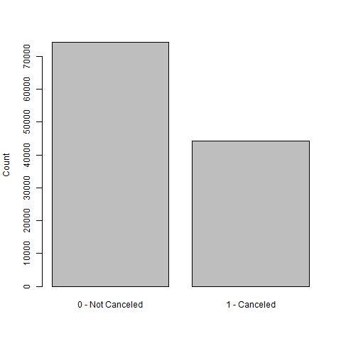
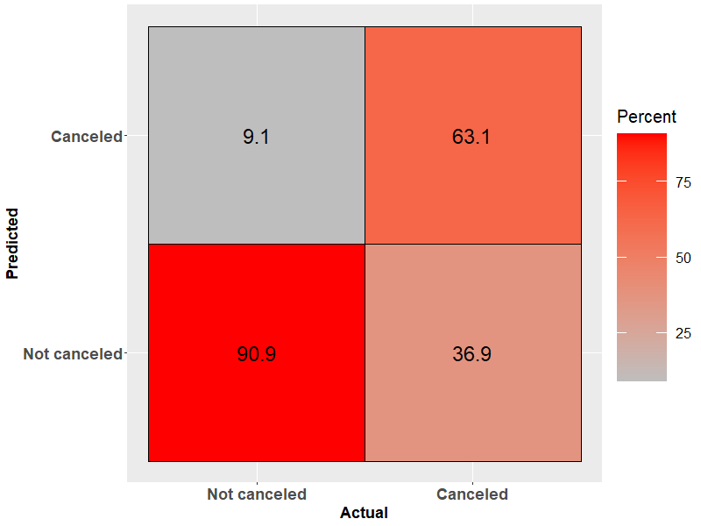
Logistic Regression Model To Predict Hotel Cancellations
Stratified train test split using 75% data for training and 25% data for testing
Features removed after VIF check for multicollinearity
distribution_channel
Features with insignificant coefficients removed-
arrival_date_day_of_month
arrival_date_week_number
required_car_parking_spaces
Confusion Matrix
Reduced Model Performance Metrics:
Misclassification Rate = 0.1714912
Precision = 0.6307531
Recall = 0.7400791
F1 Score = 0.6810567
Sensitivity = 0.7400791

Slide 10
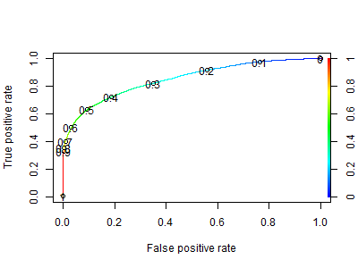
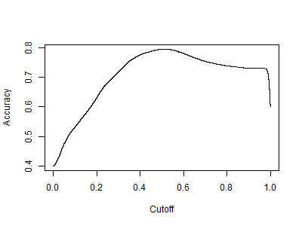
Logistic Regression - Optimizing the threshold value using the ROC metric
The threshold of 0.5 gives the best accuracy in the model and shows good balance between the true and false positive rates.

Slide 11
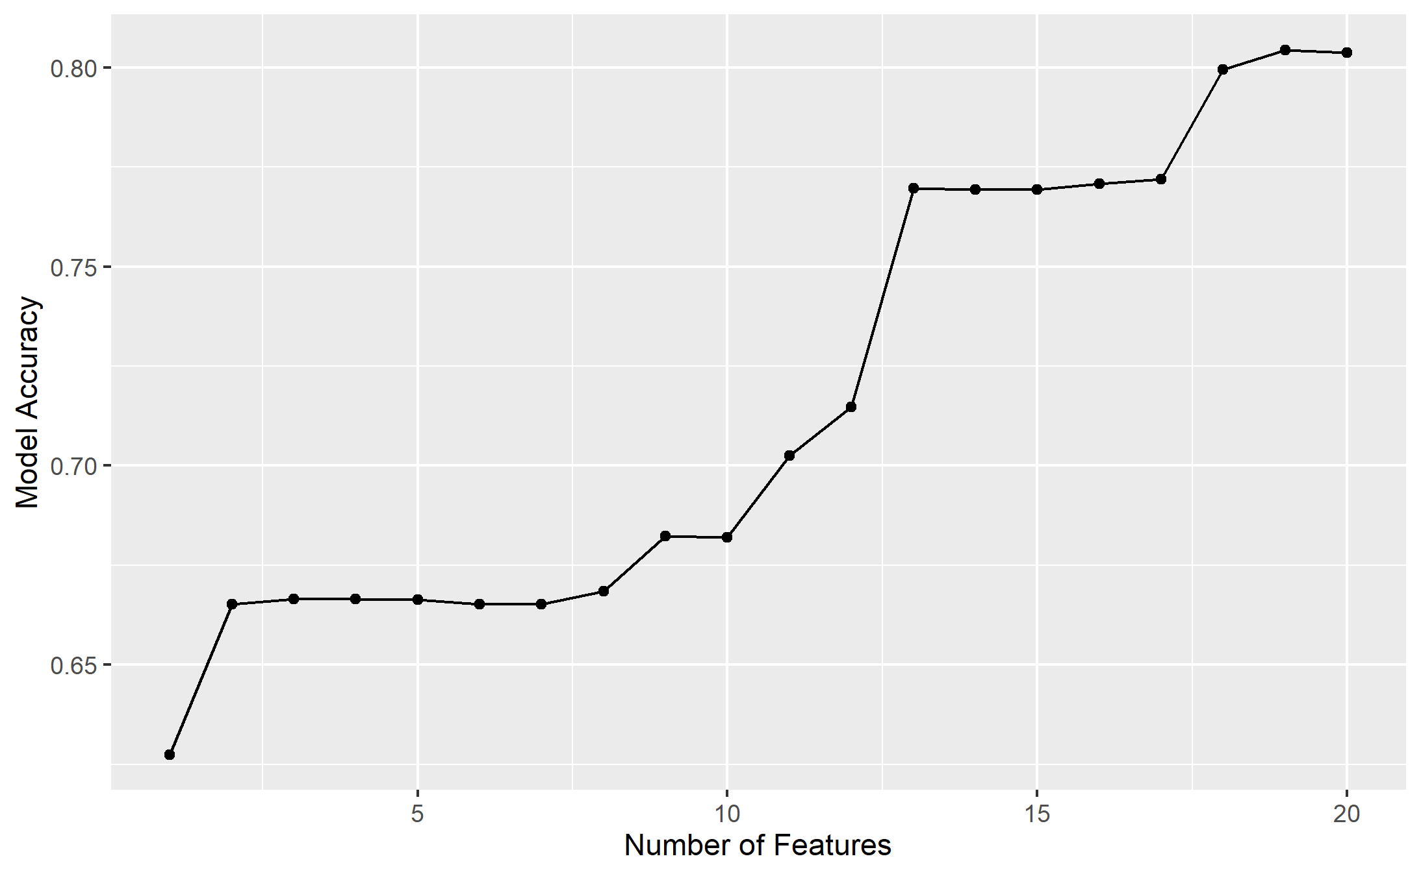
Logistic Regression
Stratified K-fold Cross-Validation Performed
Used response variable as strata
K-fold (10) Cross Validation: 20.1%
10-fold Cross-Validation for Feature Selection by sequentially adding features to the model.
The accuracy rate does not improve beyond the first 18 features in the model.
We consider removing consistent_room_type and arrival_date_season from our final logistic regression model.

Slide 12
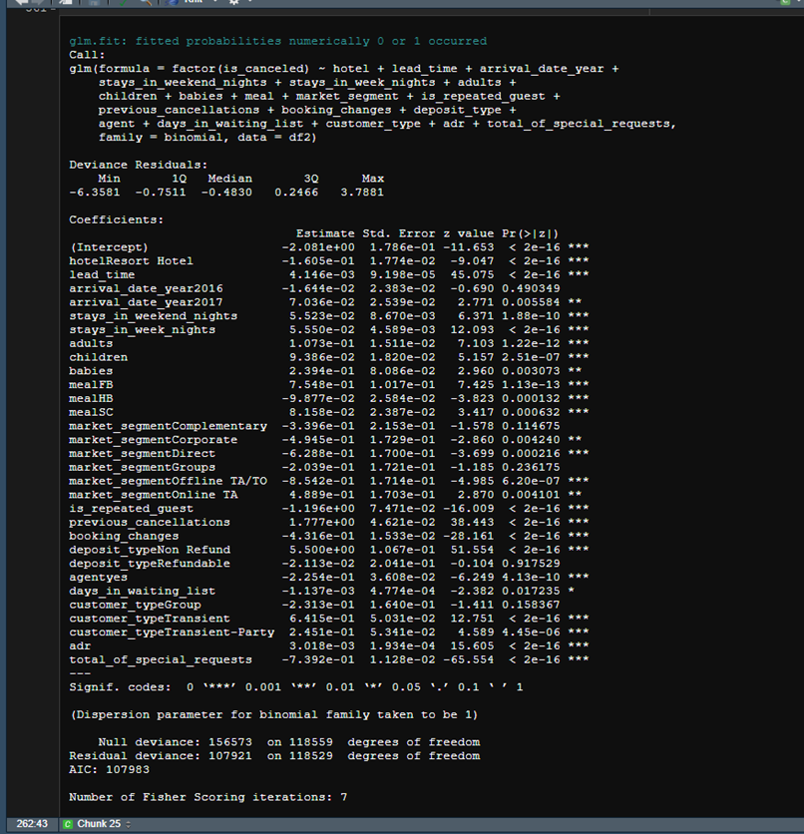
Logistic Regression - Model Interpretation
Features with a positive influence:
City Hotel
Lead Time
Arrival in the year 2017 compared with years 2015 and 2016
No meal package
Bookings made online
Previous cancellations by the customer
Transient Customer Type
Average daily Rate
Features with a negative influence:
Resort Hotel
Half-board meal package (breakfast and dinner)
Complementary and corporate bookings; Group bookings; Bookings through travel agents and tour operators
Repeated guests
Bookings Changes
Special Requests

Slide 13
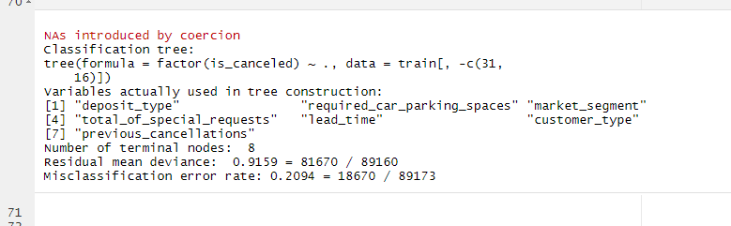
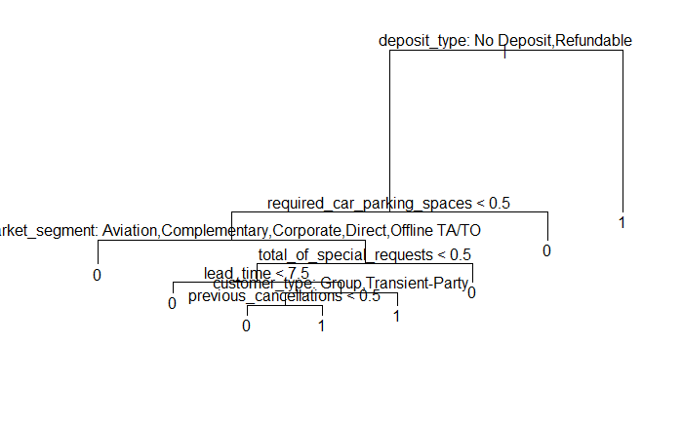

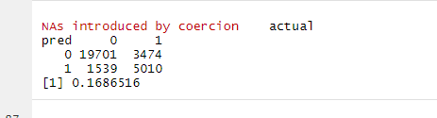
Classification Tree
30% of all cancellations

Slide 14
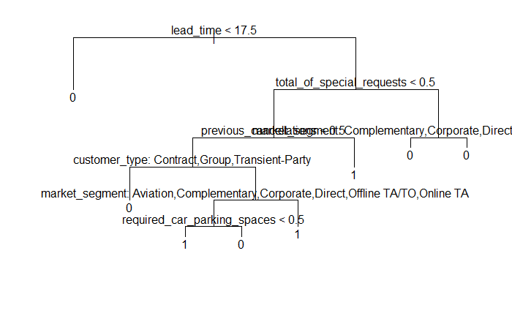
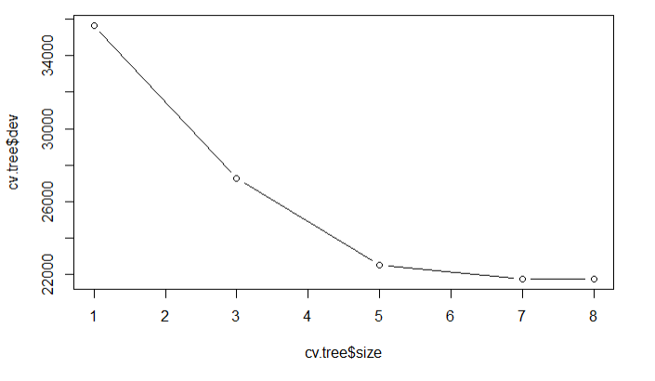
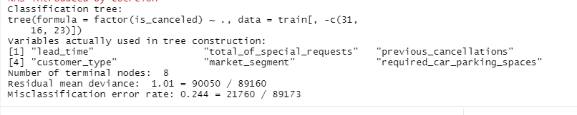
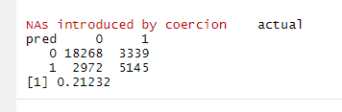

Slide 15
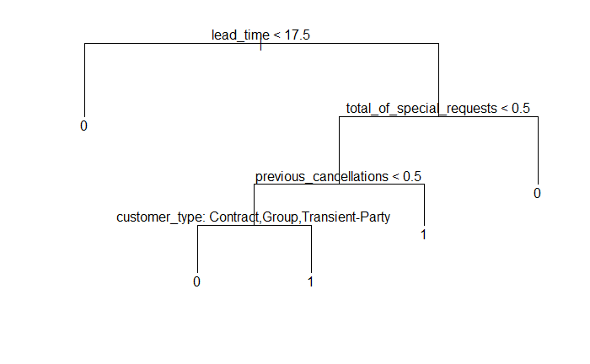
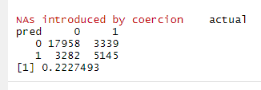
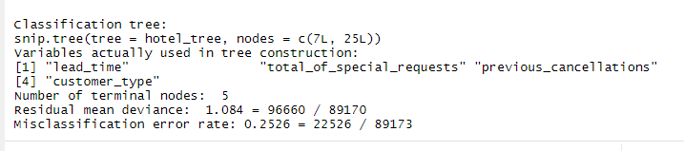

Slide 16

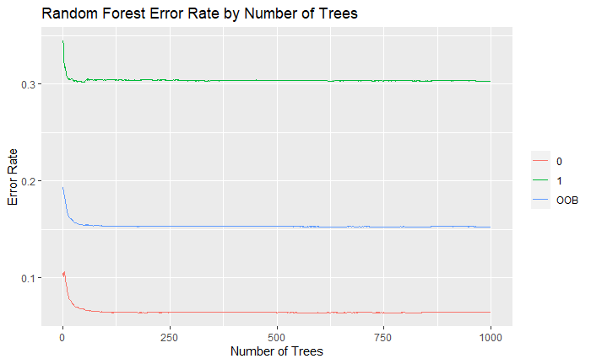

Random Forest Analysis
Required another method of modelling not inhibited by categorical variables and normal distribution
Attempted to run Random Forest Analysis, n=1000, mtry = 4
Misclassification Rate:
OOB Error: 15.29%
K-fold (10), Cross-Validation: 17.6%, mtry = 16
Very high error predicting cancelation. Model likely overfit.

Slide 17
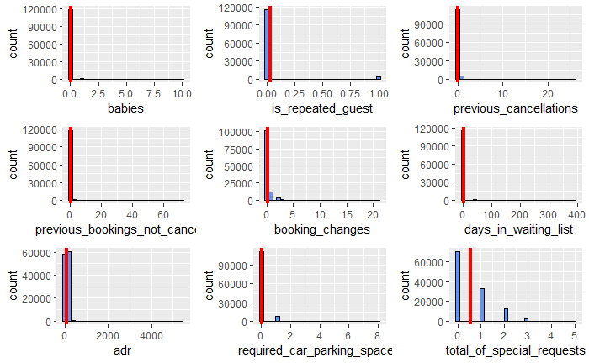
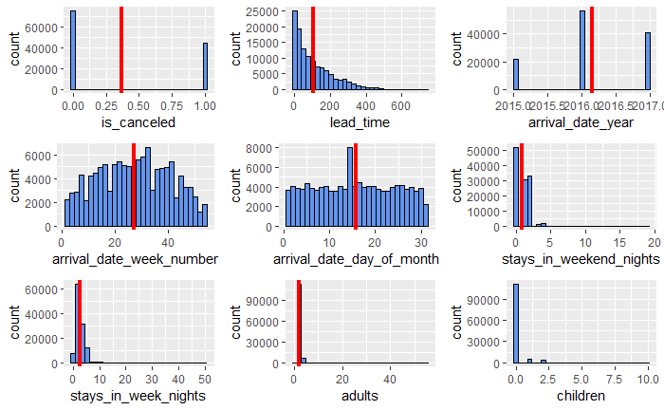
Linear & Quadratic Discriminant Analysis
Equivalent variables used in Logistic Regression Model
Data largely consists of categorical variables , few numerical variables which exist not normally distributed

Slide 18
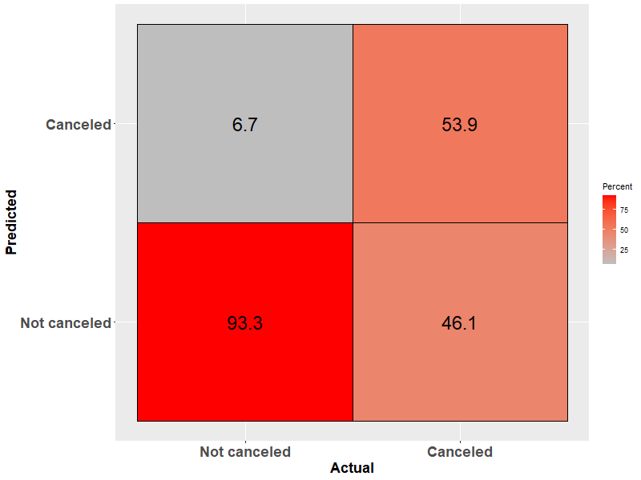
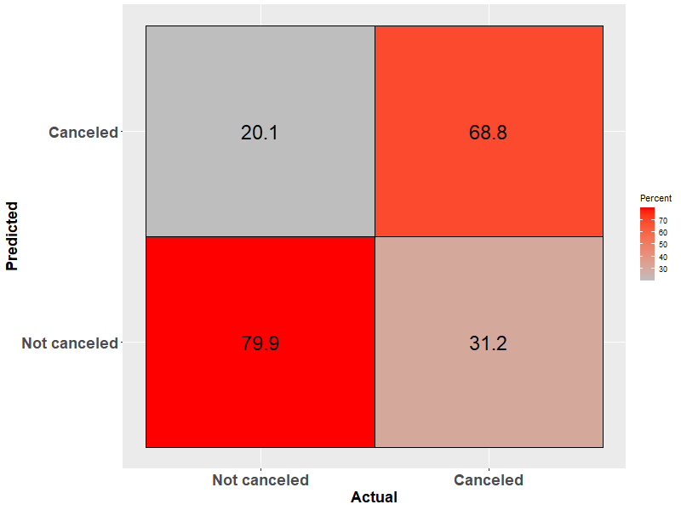
Linear & Quadratic Discriminant Analysis
Analysis still completed out of curiosity
LDA Misclassification Rate Results:
Validation Approach (75/25 Split): 17.8%
K-fold (10) Cross Validation: 21.8%
QDA Misclassification Rate Results:
Validation Approach (75/25 Split): 23.2%
K-fold (10) Cross Validation: 24.3%
LDA (VA) Confusion Matrix
QDA (VA) Confusion Matrix

Slide 19
Model Summary
Classification Method | Misclassification Rate
 | Validation Approach | Cross Validation
Logistic Regression | 17.1 % | 20 %
LDA* | 17.8% | 21.8%
QDA* | 23.2% | 24.3%
Random Forest | 15.2% | 17.5%
Classification Tree | 22.27% (pruned) | 23.65%

Slide 20
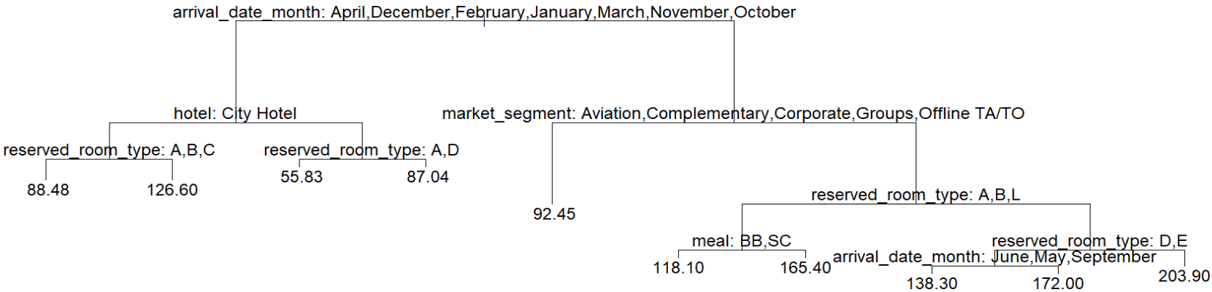
Research Question 3: Using regression tree, which variables are important in predicting average daily rate of a hotel stay in Portugal?
We plot a regression tree using the tree() function with adr (average daily rate) as the response, our predictors are all other variable that are either quantitative or categorical that has less than 32 levels (due to constraints with tree() function).
Using validation set approach for cross validation, we use 75% of data for training, 25% for testing.
Cross-validation error: RMSE = €33.89, this is the standard deviation of the unexplained variance by the model
Results Interpretation:
Arrival Month - Warmer months (May to September, especially July to August) lead to higher average daily rate.
Hotel - Hotel in resort region is cheaper than hotel in the city in colder months.
Market Segment - Market segment pays a major role in pricing, with Direct Booking and Online Travel Agents resulting in more expensive rates as compared to corporate and groups.
Meal Plan - Meal plans contributes to higher prices, with no meal/breakfast cheaper than Half/Full Board

Slide 21
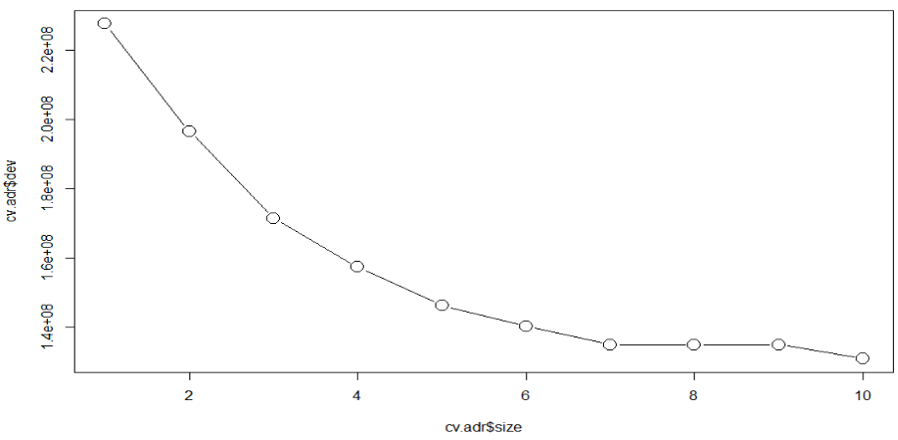
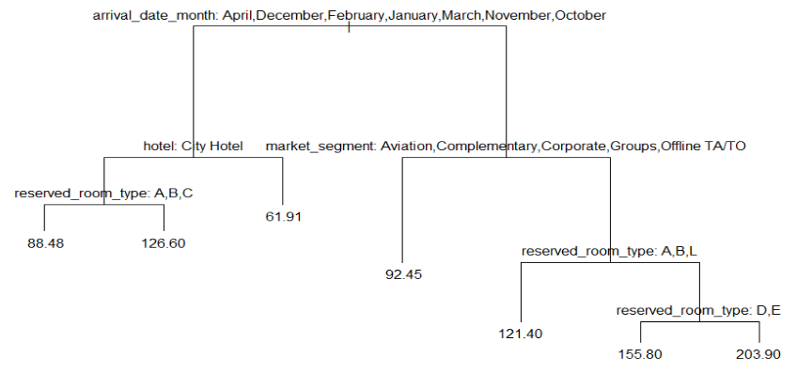
Research Question 3: (cont.) Pruned Regression Tree
We now prune the tree. Graph below is CV error vs size of tree, we see that the cross-validation error is smallest at 10 terminal nodes, but improvement seemed to plateau at 7 terminal nodes, we will prune our tree to 7 terminal nodes for a simpler model.
Cross-validation error: RMSE = €34.96 (vs. €33.89 of the un-pruned tree)
Compared to the un-pruned tree, pruned tree does not make use of the 'meal' feature.

Slide 22
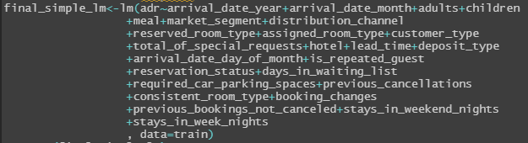

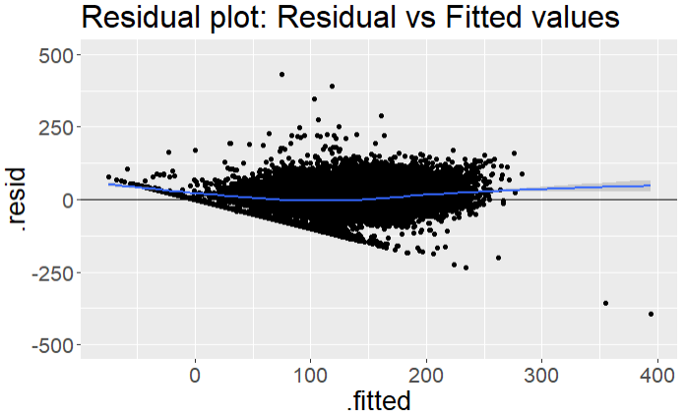

Research Question 3: (cont.) Linear Regression
Just as a comparison, we also built a simple first order multiple linear regression model using methods learnt in DATA603 and used validation set approach for cross validation.
Here is a summary of the key steps to build the model, full steps will be in the report.
Step 1: Start with a full model with all variables (do f-test to check that at least one variable is significant)
Step 2: Remove Aliased variables (ex. 'arrival_date_season' is an alias of 'arrival_date_month')
Step 3: Use Stepwise regression (P_ent = 0.05, P_rem = 0.1) to reduce the full model (do ANOVA / f-test to check no significant variables are removed)
Step 4: Check for multicollinearity and model assumptions
Cross-validation error: RMSE = €29.91, which is smaller than €34.96 (pruned tree) and €33.89 (un-pruned tree)
Note that at α = 0.05, homoscedasticity assumption was met, linearity and normality assumptions were not met, suggesting that a linear model may not be a good choice

Slide 23
Conclusion
For Research Question 1: Contingency tables –the response variable is_canceled is dependent on all categorical tested features.
Classification Method​ | Misclassification Rate​
 | Validation Approach​ | Cross Validation​
Logistic Regression​ | 17.1 %​ | 20 %​
LDA*​ | 17.8%​ | 21.8%​
QDA*​ | 23.2%​ | 24.3%​
Random Forest​ | 15.2%​ | 17.5%​
Classification Tree​ | 22.27% (pruned)​ | 23.65%​
For Research Question 2: Random forest appears to be the best model for predicting booking cancellations with the lowest misclassification rate of 15.2% against the test data, and 17.5% in cross-validation.
For Research Question 3: Using regression tree, the variables shown to be important in predicting average daily rate of a hotel stay in Portugal are: Arrival Month, Hotel Type, Market Segment, and Meal Plan.

Slide 24
References
(1) Total tourism contribution to GDP in Portugal 2020 | Statista
(2) Portugal Contribution of travel and tourism to GDP (% of GDP), 1995-2019 - knoema.com
(3) Homepage | www.visitportugal.com
(4) Hotel booking demand | https://www.kaggle.com/jessemostipak/hotel-booking-demand
(5) Hotel booking demand datasets | https://doi.org/10.1016/j.dib.2018.11.126

Slide 25
Thank You!
Group 4 - Harold Lee, Radhika Joshi, Alex Papparis, David St. George, Daniel Zhou

